Slide 1
POINTLESS
GB’s most famous
Notes:
Click to add Notes

Slide 2
Rules
"Name the LEAST FAMOUS British person that fits the category. The fewer people who know it, the lower your score!"
No answer/incorrect answer – 100pts
3^{rd -} 50pts
2nd – 30pts
1st – 10pts
Lowest score at the end wins!
Answers are from https://quiz-questions.uk/. So if you don’t agree, take it up with them.

Slide 3
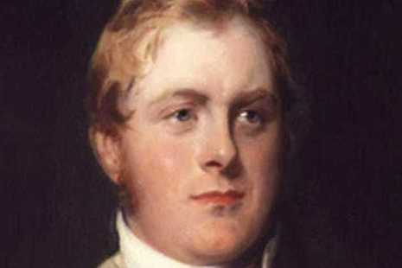
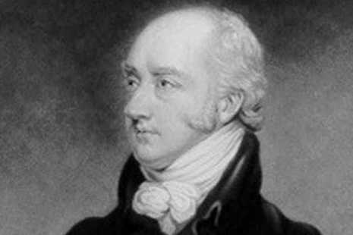
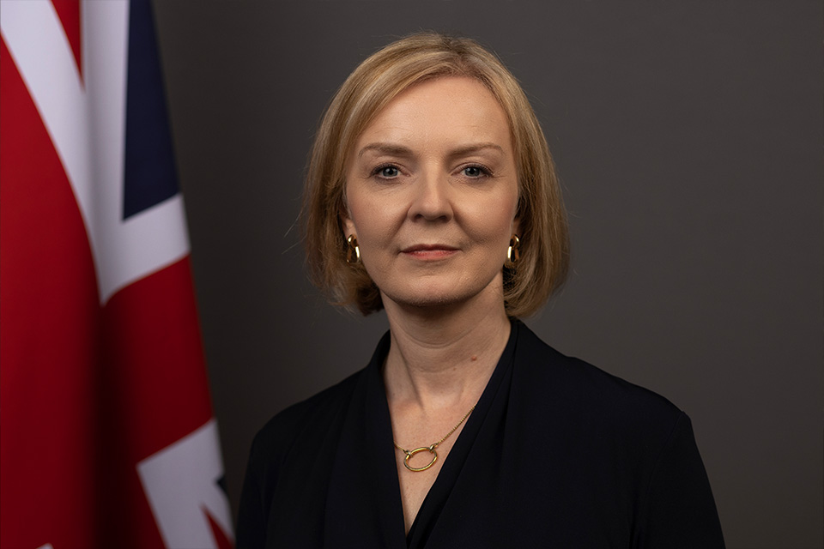
Question 1: Name a PM who served for LESS THAN 1 YEAR

Slide 4
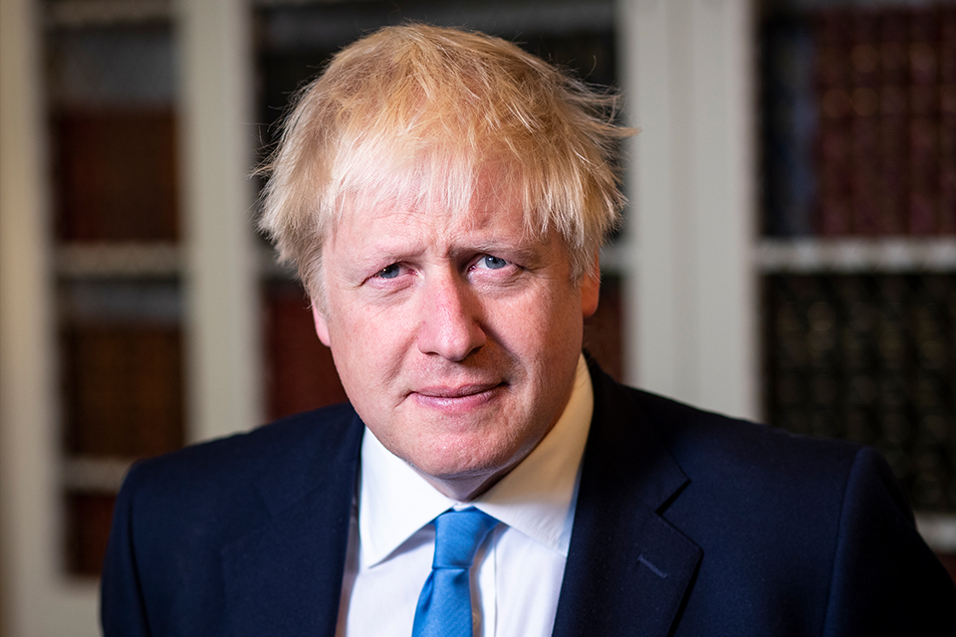
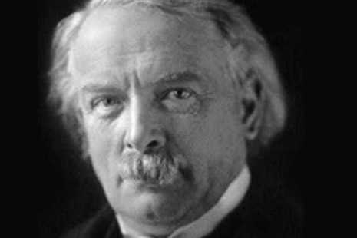
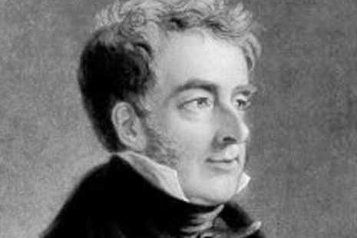
Question 2 - Name a PM who resigned over a scandal.

Slide 5
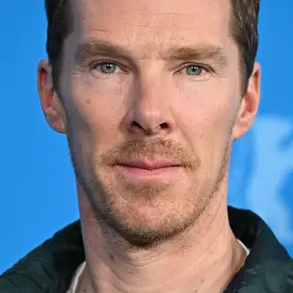
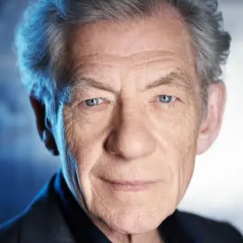
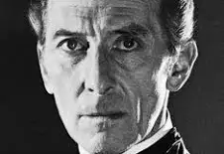
Questions 3 Which British actor played both Sherlock Holmes

Slide 6
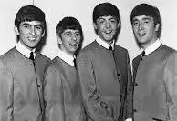
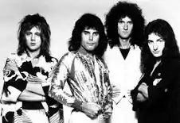
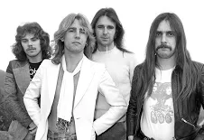
Questions 4 - Which British band has the most UK No. 1 singles?

Slide 7
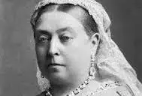
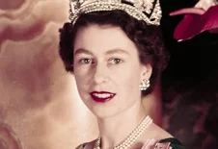
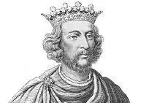
Question 5 Name a British monarch who ruled for over 60 years

Slide 8
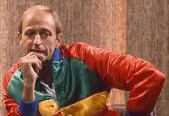
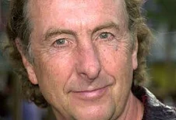
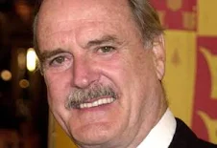
Question 6 – Name a member of Monty Python

Slide 9
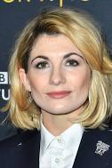
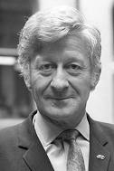
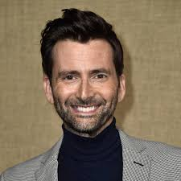
Question 7 Name an actor/actress who played Doctor Who

Slide 10
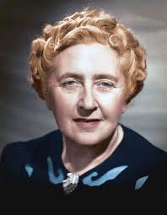
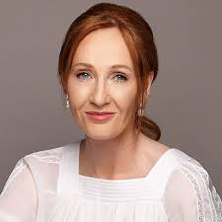
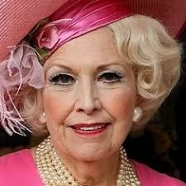
Questions 8 – Bestselling Female authors

Slide 11
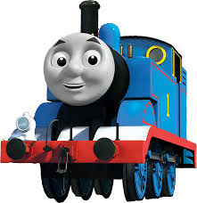
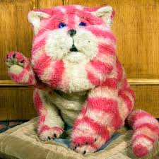
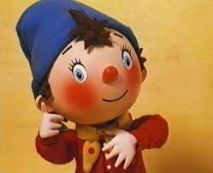
Question 9 Name a British cartoon or children's TV show that aired on the BBC before 2000

Slide 12
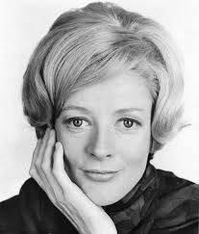
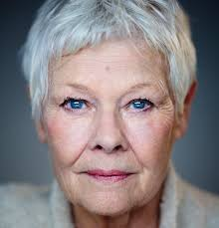
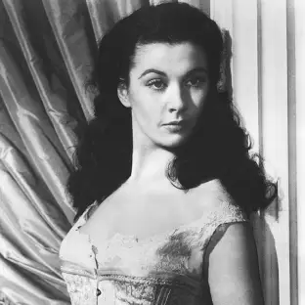
Question 10 Which British actress has won the most Oscars?

Slide 13
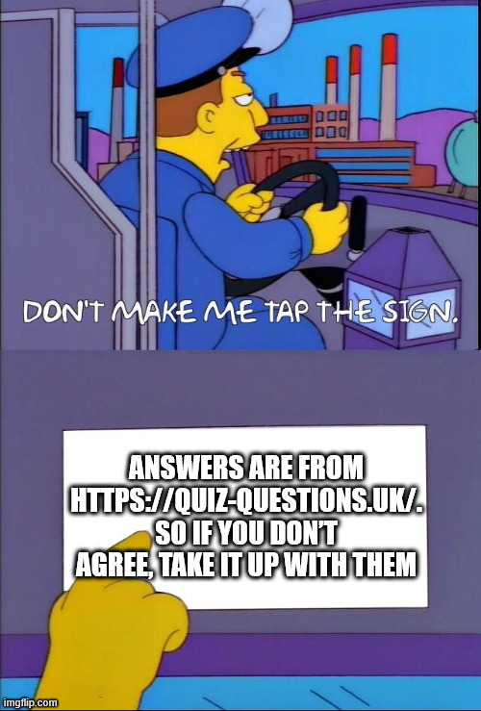
Answers

Slide 14
Question 1: Name a PM who served for LESS THAN 1 YEAR
Lord Goderich 144 days – 10 pts
George Canning 119 days – 30 pts
Liz Truss – 49 Days – 50 pts

Slide 15
Question 2 - Name a PM who resigned over a scandal.
Boris Johnson – 50 pts
David Lloyd George – 30 pts
Lord Melbourne – 10 pts

Slide 16
Questions 3 Which British actor played both Sherlock Holmes
Benedict Cumberbatch –50 pts
Sir Ian McKellen – 30 pts
Peter Cushing – 10 pts

Slide 17
Questions 4 - Which British band has the most UK No. 1 singles?
The Beatles – 50 pts
Queen – 30 pts
Status Quo –10 pts

Slide 18
Question 5 Name a British monarch who ruled for over 60 years
Queen Victoria – 30 pts
Queen Elizabeth II – 50 pts
King Henry III – 10 pts

Slide 19
Question 6 – Name a member of Monty Python
Graham Chapman – 10 pts
Eric Idle – 30 pts
John Cleese – 50 pts

Slide 20
Question 7 Name an actor/actress who played Doctor Who
David Tennant – 50 pts
Josie Whittaker – 30 pts
Jon Pertwee – 10 pts

Slide 21
Questions 8 – Bestselling Female authors
JK Rowling – 50 pts
Agatha Christie – 30 pts
Barbara Cartland – 10 pts

Slide 22
Question 9 Name a British cartoon or children's TV show that aired on the BBC before 2000
Thomas the tank engine – 50 pts
Bagpuss – 30 pts
Noddy – 10 pts

Slide 23
Question 10 Which British actress has won the most Oscars?
Judi Dench – 50 pts
Maggie Smith – 30 pts
Vivien Leigh – 10 pts

Slide 24
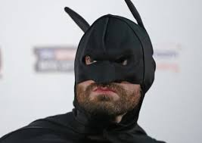
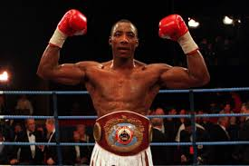
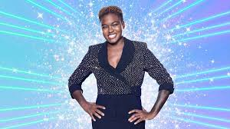
Tiebreaker – Name a British boxer (male or female) who has held a major world championship title

Slide 25
Tiebreaker – Name a British boxer (male or female) who has held a major world championship title
Tyson Fury – 50 pts
Nicola Adams – 30 pts
Johnny Nelson – 10 pts

